Slide 1
Spectrum
SHOP
Members:
Maliha Zaman 200042114
Nazia Karim Khan Oishee 200042137
Mohammad Ittehad Rahman Sami 200042131

Slide 2
Introduction
Spectrum is a website portal for different small and large pages and brands to sell their respective products.
Spectrum holds the basic properties of an e-commerce website along with an addition built-in chat system that allows the customers to communicate with the respective business owner.

Slide 3
Features
PAY
01
Buy/Sell
02
Review
03
Report
04
Chat system

Slide 4
Buy/Sell
Buy
Sell
Customers can access and buy products from our website
Brands and pages can sell products through our website

Slide 5
Review
Brands and pages can sell products through our website

Slide 6
Chat System
Chat
Built-in chat system through which our customer can have direct contact with the owners of products on display.

Slide 7
Implementation
Before Progress Presentation
$
After Progress Presentation
Basic layout of the website, authentication, add product as seller
Display products, chat system, review, add to cart and payment

Slide 8
Team Contribution
Nazia Karim Khan Oishee
Maliha
Zaman
Mohammad Ittehad Rahman Sami
Venus has a beautiful name
Mars is a very cold place
Neptune is the farthest planet

Slide 9
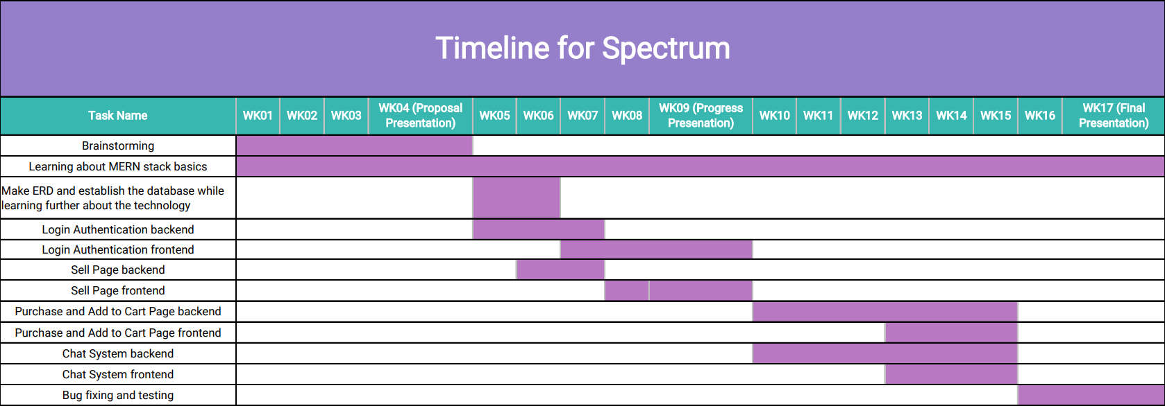
Timeline

Slide 10
Demonstration
Sell
Review
Authentication
Purchase
Chat system

Slide 11
THANK
YOU

